Slide 1
LA HEALTH
2025 Member Sales Presentation

Slide 2
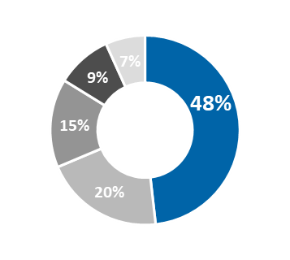
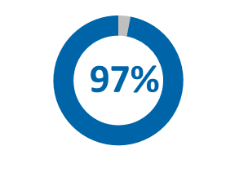
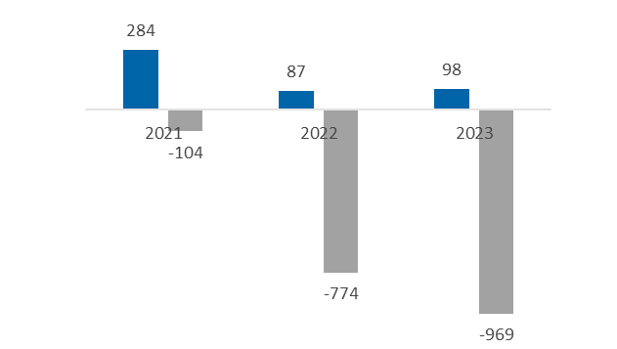
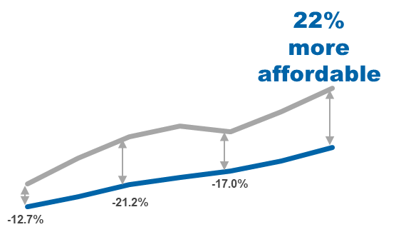

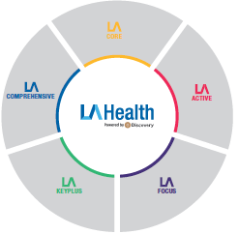


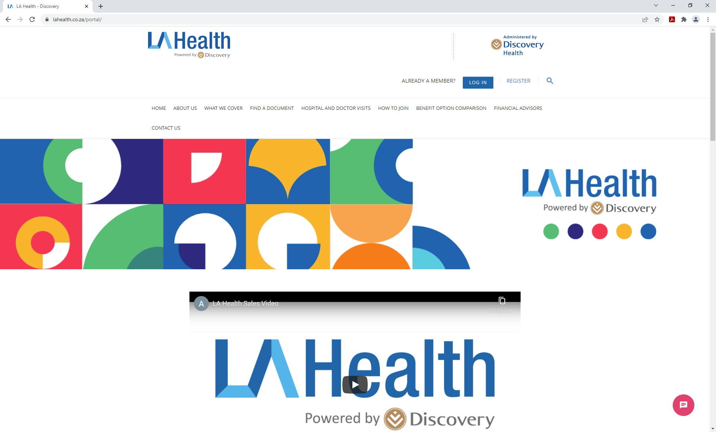

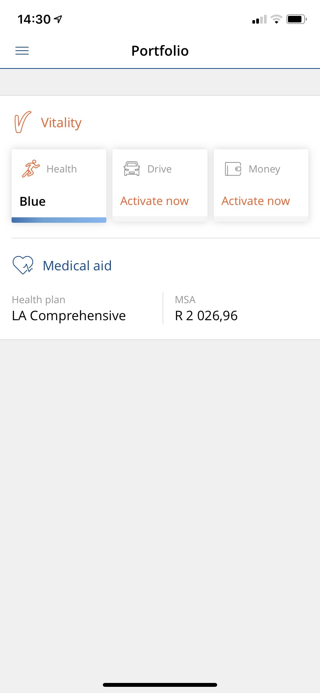


LA HEALTH’S VALUE PROPOSITION FOR
LOCAL GOVERNMENT EMPLOYEES
Scheme of choice
Financial & operational sustainability
Richest benefits and extensive networks
Most affordable contributions
Net Healthcare result (2021-2023)
Overall Scheme in-hospital cover ratio
Beneficiaries benefit from on average 22% more affordable contributions
Full spectrum of benefit options
Enhanced member experience through digital tools
Access to Vitality, the world’s leading wellness programme

Slide 3
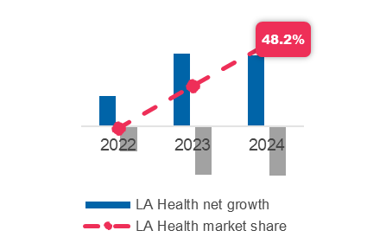
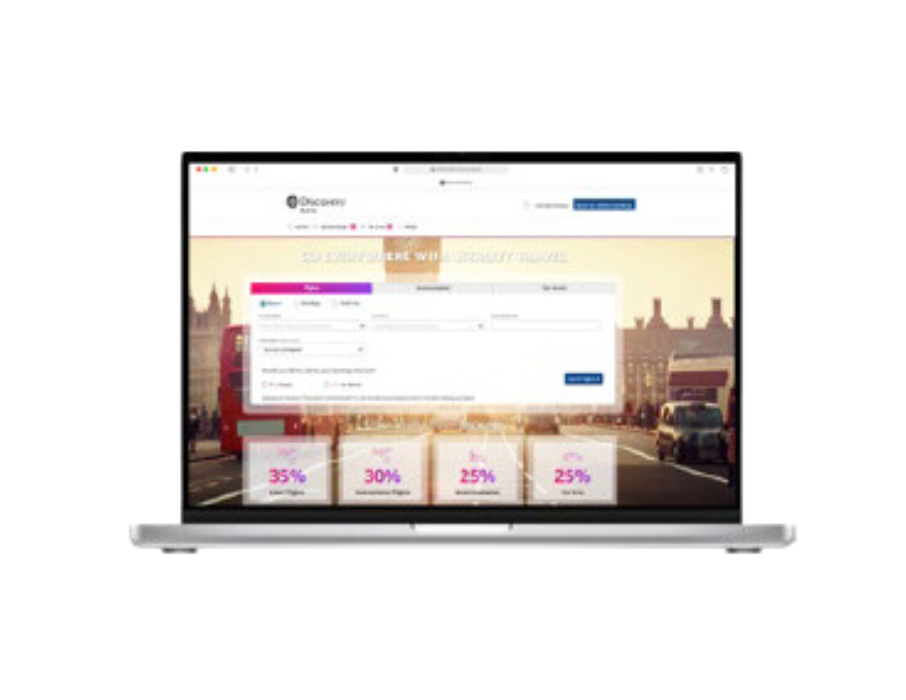







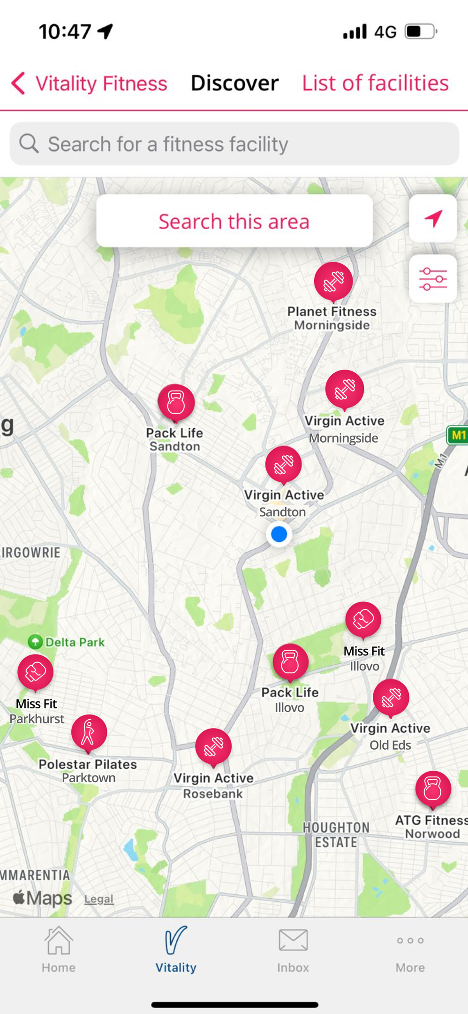

comprehensive, value-for-money care for local government employees
Scheme of Choice for local government employees
Ensuring highest quality care & service for members
LA Health Benefit Option summary
Ensuring sustained value for members
Promoting wellness and a healthy lifestyle
SALGA growth & market share
More affordable than the market

Slide 4
comprehensive, value-for-money care for local government employees
Scheme of Choice for local government employees
Ensuring highest quality care & service for members
LA Health Benefit Option summary
Ensuring sustained value for members
Promoting wellness and a healthy lifestyle
SALGA growth & market share
More affordable than the market

Slide 5
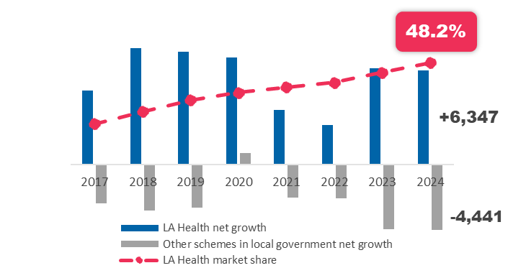
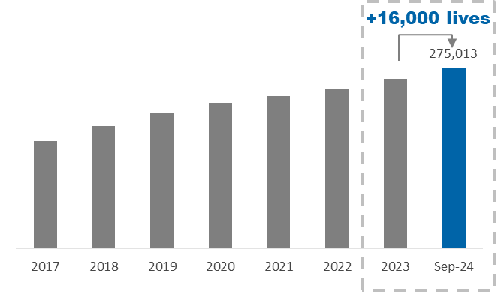
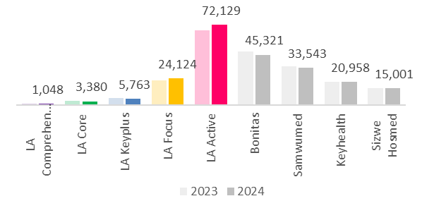
LA Health’s consistent growth is an outlier in the local government sector
LA Health now has over 275 000 beneficiaries
The Scheme has nearly 50% market share within local government
LA Active is 59% larger than the next largest scheme in local government
LA Health total beneficiaries
(2017 to September 2024)
Net growth & market share of principal members
(LA Health vs rest of local government sector)
Membership size
Total principal members as at March 2024
Total principal members as at
31 March 2024
LA Health
Next largest scheme in local government
>106 000
<46 000
Numbers represent 12-month period ending in March every year
*(Annual member growth as at 31 March each year)

Slide 6
Quality growth has maintained the positive demographic profile of the Scheme
New joiners are younger and healthier than total membership
The Scheme’s average age is more than 6 years lower than other accredited schemes
Average age
LA Health average age versus other local government schemes
6.5 years
younger
6.3 years
lower
Chronic ratio
17
percentage points
healthier

Slide 7
Despite strong growth, the Scheme delivered a balanced operating performance in 2023
In 2023 the Scheme experienced growth and a positive net healthcare result of R32 per average beneficiary per month
Member growth rate vs net healthcare results (R pabpm)
LA Health was
the only accredited
local government scheme in 2023 to achieve member growth, and a positive operating outcome
Net healthcare calculated from scheme financial statements, under IFRS17 accounting standards

Slide 8
LA Health remains financially strong and sustainable
The Scheme’s financial position remains strong, with stable solvency and increasing reserves
LA Health independently rated the most sustainable medical scheme in South Africa
Investment income 2023
R308m
Member reserves 2023
R3.4 bn
Solvency
2023
53.3%
Alexforbes Sustainability report
LA Health accumulated funds and solvency
LA Health
Other medical schemes
Based on membership size, average age, operating result, solvency, reserves and change in these metrics
Source: 2023/2024 Alexforbes Medical Schemes Sustainability Index

Slide 9
comprehensive, value-for-money care for local government employees
Scheme of Choice for local government employees
Ensuring highest quality care & service for members
LA Health Benefit Option summary
Ensuring sustained value for members
Promoting wellness and a healthy lifestyle
SALGA growth & market share
More affordable than the market

Slide 10
















Benefit design delivers exceptional cover for members across a wide spectrum of healthcare needs
Financial protection
from extreme events
Advanced healthcare
Routine care
2,545
Members on
high cost drugs​
52,000
Hospital admissions​
693,000
GP visits
230,500
Days in hospital covered
2.9m
Pharmacy visits
1,846
ICU admissions​
29,500
Essential hypertension
75,000
Paediatrician
visits​
35
Helicopter
evacuations​
1,900
Pneumonia admissions
247,000
Allied visits
(e.g. Physiotherapist) ​
300
Members on
chronic dialysis​
3,100
Depression admissions
3,000
Deliveries
1,600
Members on oncology treatment​
455,000
Chronic scripts dispensed

Slide 11




Highest quality of care and financial protection for members from extreme events
The highest individual claims highlight that major medical treatments can be required at any age
5 of the highest LA Health claims
R3.3 M |
Age 55
Long-term use of a ventilator
89 years
worth of contributions to fund the top claim
R3.2 M |
Age 57
Lung transplant
R3.0 M |
Age 76
Long-term use of a ventilator
129
beneficiaries claimed over R1 million
R2.7 M |
Age 1
Surgery for infection/ disease
R1.2 M |
Age 11
Lymphoma
454
beneficiaries claimed over R500 000

Slide 12





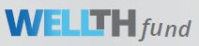



Superior healthcare quality and cover for members when accessing routine care
Extensive provider networks to minimise member shortfalls
Highest quality care through regular provider engagement
With superior high-value benefits for routine healthcare
Provider profiling and analysis
Preventative healthcare
Discovery
GP network
PROVIDER PROFILING AND ANALYSIS
Cover for various screening tests, as well as access to wellness programme for effective preventative healthcare
>5,933
Inefficiency
Report
Direct engagements
Monthly
trackers
Available to every LA Health beneficiary
Contracted GPs throughout South Africa
Supporting provider wellbeing
SUPPORTING PROVIDER
WELLBEING
Rich day-to-day cover
KeyPlus Primary Care Network
Including Medical Savings Accounts, Extended Day-to-day benefit or Above-Threshold Benefit
>2,220
Mental health routine care
Wellbeing assessment, risk-funded consultations, digital therapeutics
Contracted GPs throughout South Africa
Physical
wellbeing
Mental
wellbeing
Financial wellbeing

Slide 13


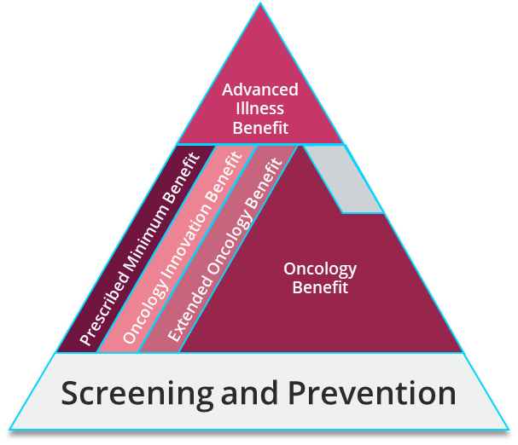


Highest quality care and provider networks to meet the advanced healthcare needs of members
Extensive provider networks to minimise member shortfalls
Exceptional in-hospital cover levels across plan range
Superior, high-value benefits for advanced healthcare
Discovery
Specialist Network
LA Health in-hospital cover ratio
Extensive Maternity benefits
Including post-birth benefits
97%
Oncology Benefit
Including Oncology Innovation Benefit & Oncology Precision Benefit for access to novel medication
>5,400
In-hospital cover levels maintained across all plans
Chronic Illness Benefit
Dedicated care for members with chronic illness
Contracted Specialists throughout South Africa
Mental Health Programme
Comprehensive mental health benefits including in-hospital and out-of-hospital care

Slide 14

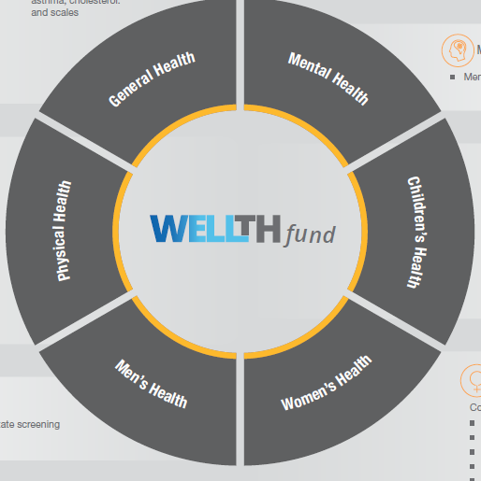


Proactive, preventative screening has unlocked additional value for members
Top 5 claims paid by provider type
18%
of memberships have unlocked their WELLTH Fund benefits
R14 M
R6 M
R3 M
R70M
in additional day-to-day benefits
R2 M
R1 M
R3,650
Average value per membership
Average value of additional WELLTH Fund benefits

Slide 15
Proactive, preventative screening has unlocked additional value for members
Incentivising member screening has had unprecedented success in driving healthy member behaviour
Number of beneficiaries completing screening assessments
Wellness rewards unlocked for members
11 X increase
37,000
Vouchers redeemed in 2023

Slide 16
comprehensive, value-for-money care for local government employees
Scheme of Choice for local government employees
Ensuring highest quality care & service for members
LA Health Benefit Option summary
Ensuring sustained value for members
Promoting wellness and a healthy lifestyle
SALGA growth & market share
More affordable than the market

Slide 17





Unlimited hospital cover available to members
Hospital benefit | There is no limit to your overall hospital cover. You need to authorise your stay in hospital. Receive full cover for planned PMB treatment and care through the KeyCare hospital network
Specialist cover | Avoid co-payments when you visit a specialist in our network
Ambulance benefit | Access to life saving emergency support through Discovery 911 on all LA Options
Do you need to use a network hospital for non-PMB care? | × | × | × | ✓ | ✓

Slide 18

Comprehensive maternity and post birth benefits
Ultrasound scans and prenatal screening
Mothers are covered for up to two 2D ultrasound scans and one Nuchal Translucency or Non-invasive Prenatal Test (NIPT) screening
GP and Specialist visits
Babies are covered for up to two visits with a GP, paediatrician or an ENT
Antenatal consultations
Mothers are covered for up to 8 gynaecologist, GP or midwife visits
Nutrition assessment
Mothers are covered for one postnatal assessment with a dietician
Postnatal consultation
Mothers are covered for one consultation with a GP or gynaecologist for post-birth complications
Mental health
Up to two postnatal mental health consultations with a counsellor or psychologist
Blood tests
Cover for a defined list of routine blood tests
Lactation consultation
Mothers are covered for one lactation consultation with a registered nurse or lactation specialist
Antenatal classes or consultations with a nurse
Mothers have cover for up to five pre- or postnatal classes or consultations with a registered nurse

Slide 19
Day-to-day cover available to members
Medical Savings Account | ✓ | ✓ | ✓ | ✓ | Out-of-hospital cover is covered from risk at a network of providers. Unlimited cover for medically appropriate GP consultations, blood tests, x-rays or medicine
Extended day to day benefit | × | ✓ | ✓ | ×
Above Threshold Benefit | ✓ | × | × | ×

Slide 20










LA KeyPlus members have comprehensive day-to-day benefits paid from risk
Out-of-hospital cover from risk at a network of providers
Cover for eye care
Unlimited GP visits
Blood, urine and other fluid and tissue tests
Basic x-rays
Casualty visits
Day-to-day medicine
Two out of network clinic-based visits per year
Trauma Recovery Extender Benefit
Cover for dentistry
Medical equipment

Slide 21
Chronic illness cover
PMB conditions | These are paid for from the major medical benefit on all options
Non PMB conditions | ✓ | ✓ | × | × | ×
Formulary medication | Chronic medicine is covered in full from the Scheme’s medicine list
Non-formulary medication | Chronic medication that is not on the medicine list is covered up to a monthly Chronic Drug Amount (CDA) |  |  |  | No benefit
Do you need to use a DSP? | You can get the medicine from a pharmacy in the Scheme’s broad pharmacy network |  |  |  | You can get the medicine from a Network Pharmacy or your chosen GP

Slide 22




Member Care programmes
CONDITION-SPECIFIC CARE PROGRAMMES FOR DIABETES, MENTAL HEALTH, HIV AND HEART CONDITIONS
MENTAL HEALTH CARE PROGRAMME
DIABETES CARE PROGRAMME
Access to cover for the management of depression including cover for:
Prescribed medication
Individual or group psychotherapy sessions
Additional GP consultations
Digital therapy for depression
Qualifying members have access to a relapse prevention programme
For members registered on CIB for diabetes and enrolled on the programme by a Premier Plus GP, access to:
Additional glucometer strips
Consultations with dieticians and biokineticists
Nurse educator to assist in the day-to-day management of your condition
CARDIO CARE PROGRAMME
HIV CARE PROGRAMME
For members registered on CIB for hypertension, hyperlipidaemia or ischaemic heart disease, and enrolled on the programme by a Premier Plus GP, access to:
Defined basket of care
Annual cardiovascular assessment if referred by a Premier Plus GP
For members registered on CIB for HIV and enrolled on the programme by a Premier Plus GP, access to:
Clinical care
Cover for social workers
Prescribed medicine

Slide 23
Members also have access to the following benefits
 | TRAUMA RECOVERY BENEFIT | ✓ | ✓ | ✓ | ✓ | ✓
 | ONCOLOGY PROGRAMME | ✓ | ✓ | ✓ | ✓ | ✓
 | ONCOLOGY INNOVATION BENEFIT | ✓ | ✓
 | ONCOLOGY PRECISION BENEFIT |  |  | ✓ | ✓
 | DISEASE PREVENTION PROGRAMME | ✓ | ✓ | ✓ | ✓ | ✓
 | INTERNATIONAL SECOND OPINION SERVICES | ✓ | ✓ | ✓ | ✓ | ✓
 | DISCOVERY HOME CARE | ✓ | ✓ | ✓ | ✓ | ✓

Slide 24

The Oncology Innovation and Oncology Precision Benefits give 95% of members access to innovative cancer treatments
The Oncology Innovation Benefit provides LA Comprehensive and
LA Core members with up 75% funding of high-cost medicines
Introduction of Oncology Precision Benefit in 2025, on LA Active and LA Focus options
The Oncology Innovation Benefit
The Oncology Precision Benefit
LA COMPREHENSIVE
Eleven novel oncology treatments remain available on
LA Comprehensive and LA Core Options, with funding of up to 75%
Three novel oncology treatments will be made available on the LA Focus and LA Active Options, subject to a copayment of 50%
LA ACTIVE
LA CORE
LA FOCUS
Drug name | Funding
Keytruda | 50%
Tagrisso | 75%
Xalkori | 75%
Yervoy | 75%
Darzalex | 50%
Imbruvica | 75%
Drug name | Funding
Calquence | 75%
Adcetris | 75%
Lenvima | 75%
Lynparza | 75%
Venclexta | 50%
Drug name | Funding
Keytruda | 50%
Tagrisso | 50%
Xalkori | 50%
Keytruda – prescription immunotherapy for various cancer, including skin, breast and cervical Tagrisso – oral targeted therapy, used to treat lung cancer
Xalkori – treatment for advanced lung cancer
Access from 1 January 2025

Slide 25


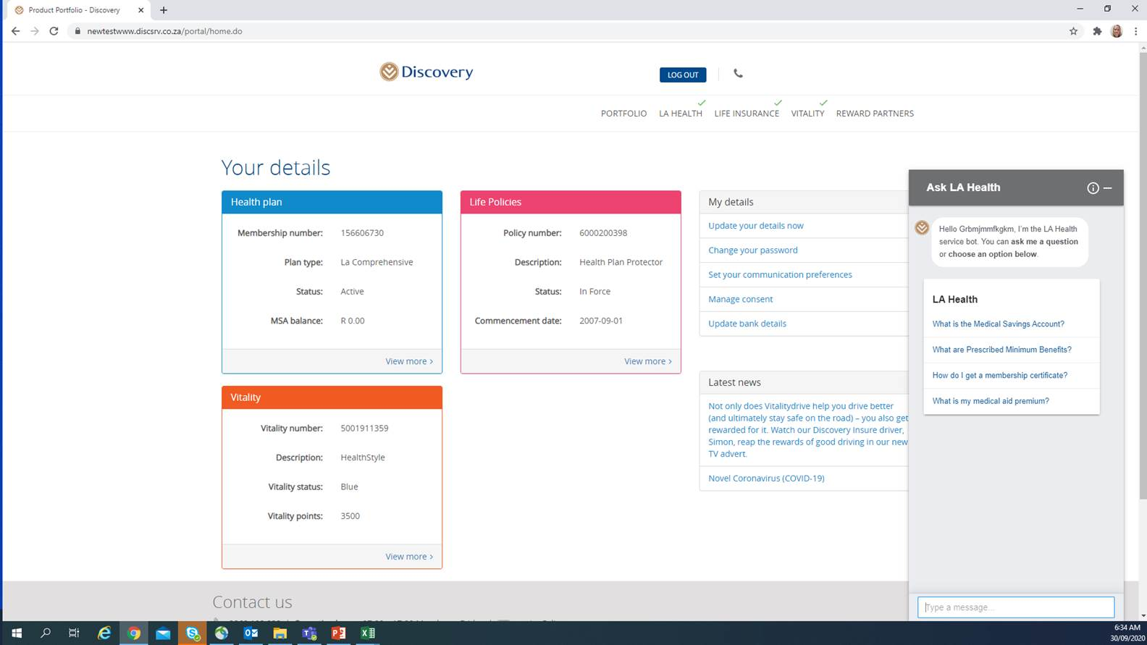



Enhanced member experience through digital tools
LA Health website
LA Health App
LA Health Social Media Pages
Enhanced real-time digital
self-service via the LA Health website, powered by our chat bot, Ask LA Health
Intuitive app navigation to access member information, submit claims and book virtual consultations
Access LA Health’s latest news, updates and information
as it becomes available online

Slide 26
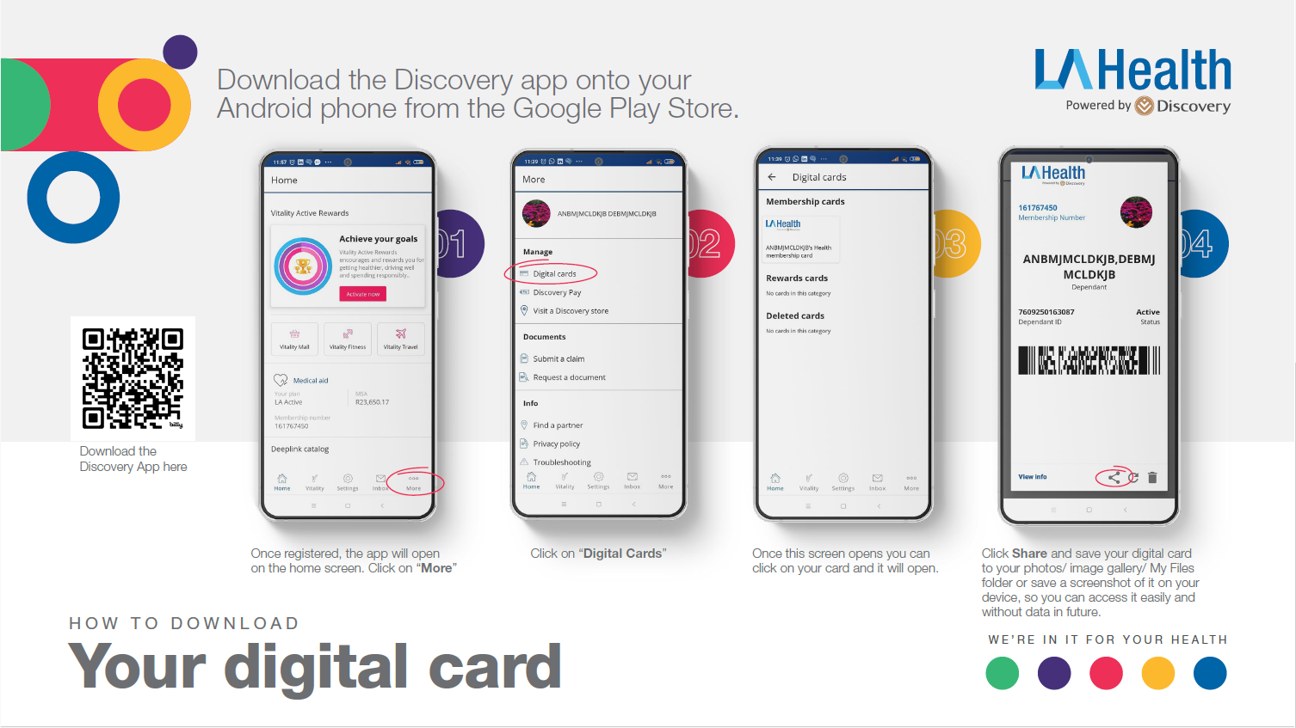

Slide 27
comprehensive, value-for-money care for local government employees
Scheme of Choice for local government employees
Ensuring highest quality care & service for members
LA Health Benefit Option summary
Ensuring sustained value for members
Promoting wellness and a healthy lifestyle
SALGA growth & market share
More affordable than the market

Slide 28
Stable operating environment allows contribution increases consistently lower than the industry
The Scheme has maintained a stable long-term operating environment
Contributions remain more affordable than the other accredited medical schemes
Net healthcare results (R million)
Average contributions (2018-2024)
22%
more affordable
-17.0%
-21.2%
-12.7%

Slide 29
2025 contribution increases
97%
of members experience an increase of
8.3% or lower
for 2025
3%
WEIGHTED AVERAGE INCREASE FOR 2025 OF 8.2%

Slide 30




Members pay competitive contributions
Income
Member
Member and Adult
Member, Adult and Child
R0 – R11 600
R11 601 - R16 200
R16 201+
R600
R633
R953
R1 124
R1 186
R1 800
R1 344
R1 417
R2 156
All
R1 254
R2 063
R2 430
All
R1 534
R2 565
R3 073
All
R3 049
R8 986
R11 263
All
R4 700
R12 498
R14 974
For illustrative purposes only, the tables above reflect the portion of the total contribution members will have to pay if they receive a 60% subsidy. This was determined by taking into consideration the SALGBC maximum capping of R5 514.86 that will be effective until 30 June 2025

Slide 31
comprehensive, value-for-money care for local government employees
Scheme of Choice for local government employees
Ensuring highest quality care & service for members
LA Health Benefit Option summary
Ensuring sustained value for members
Promoting wellness and a healthy lifestyle
SALGA growth & market share
More affordable than the market

Slide 32
Vitality in 2025
KNOW YOUR HEALTH
IMPROVE YOUR HEALTH
GET REWARDED

Slide 33





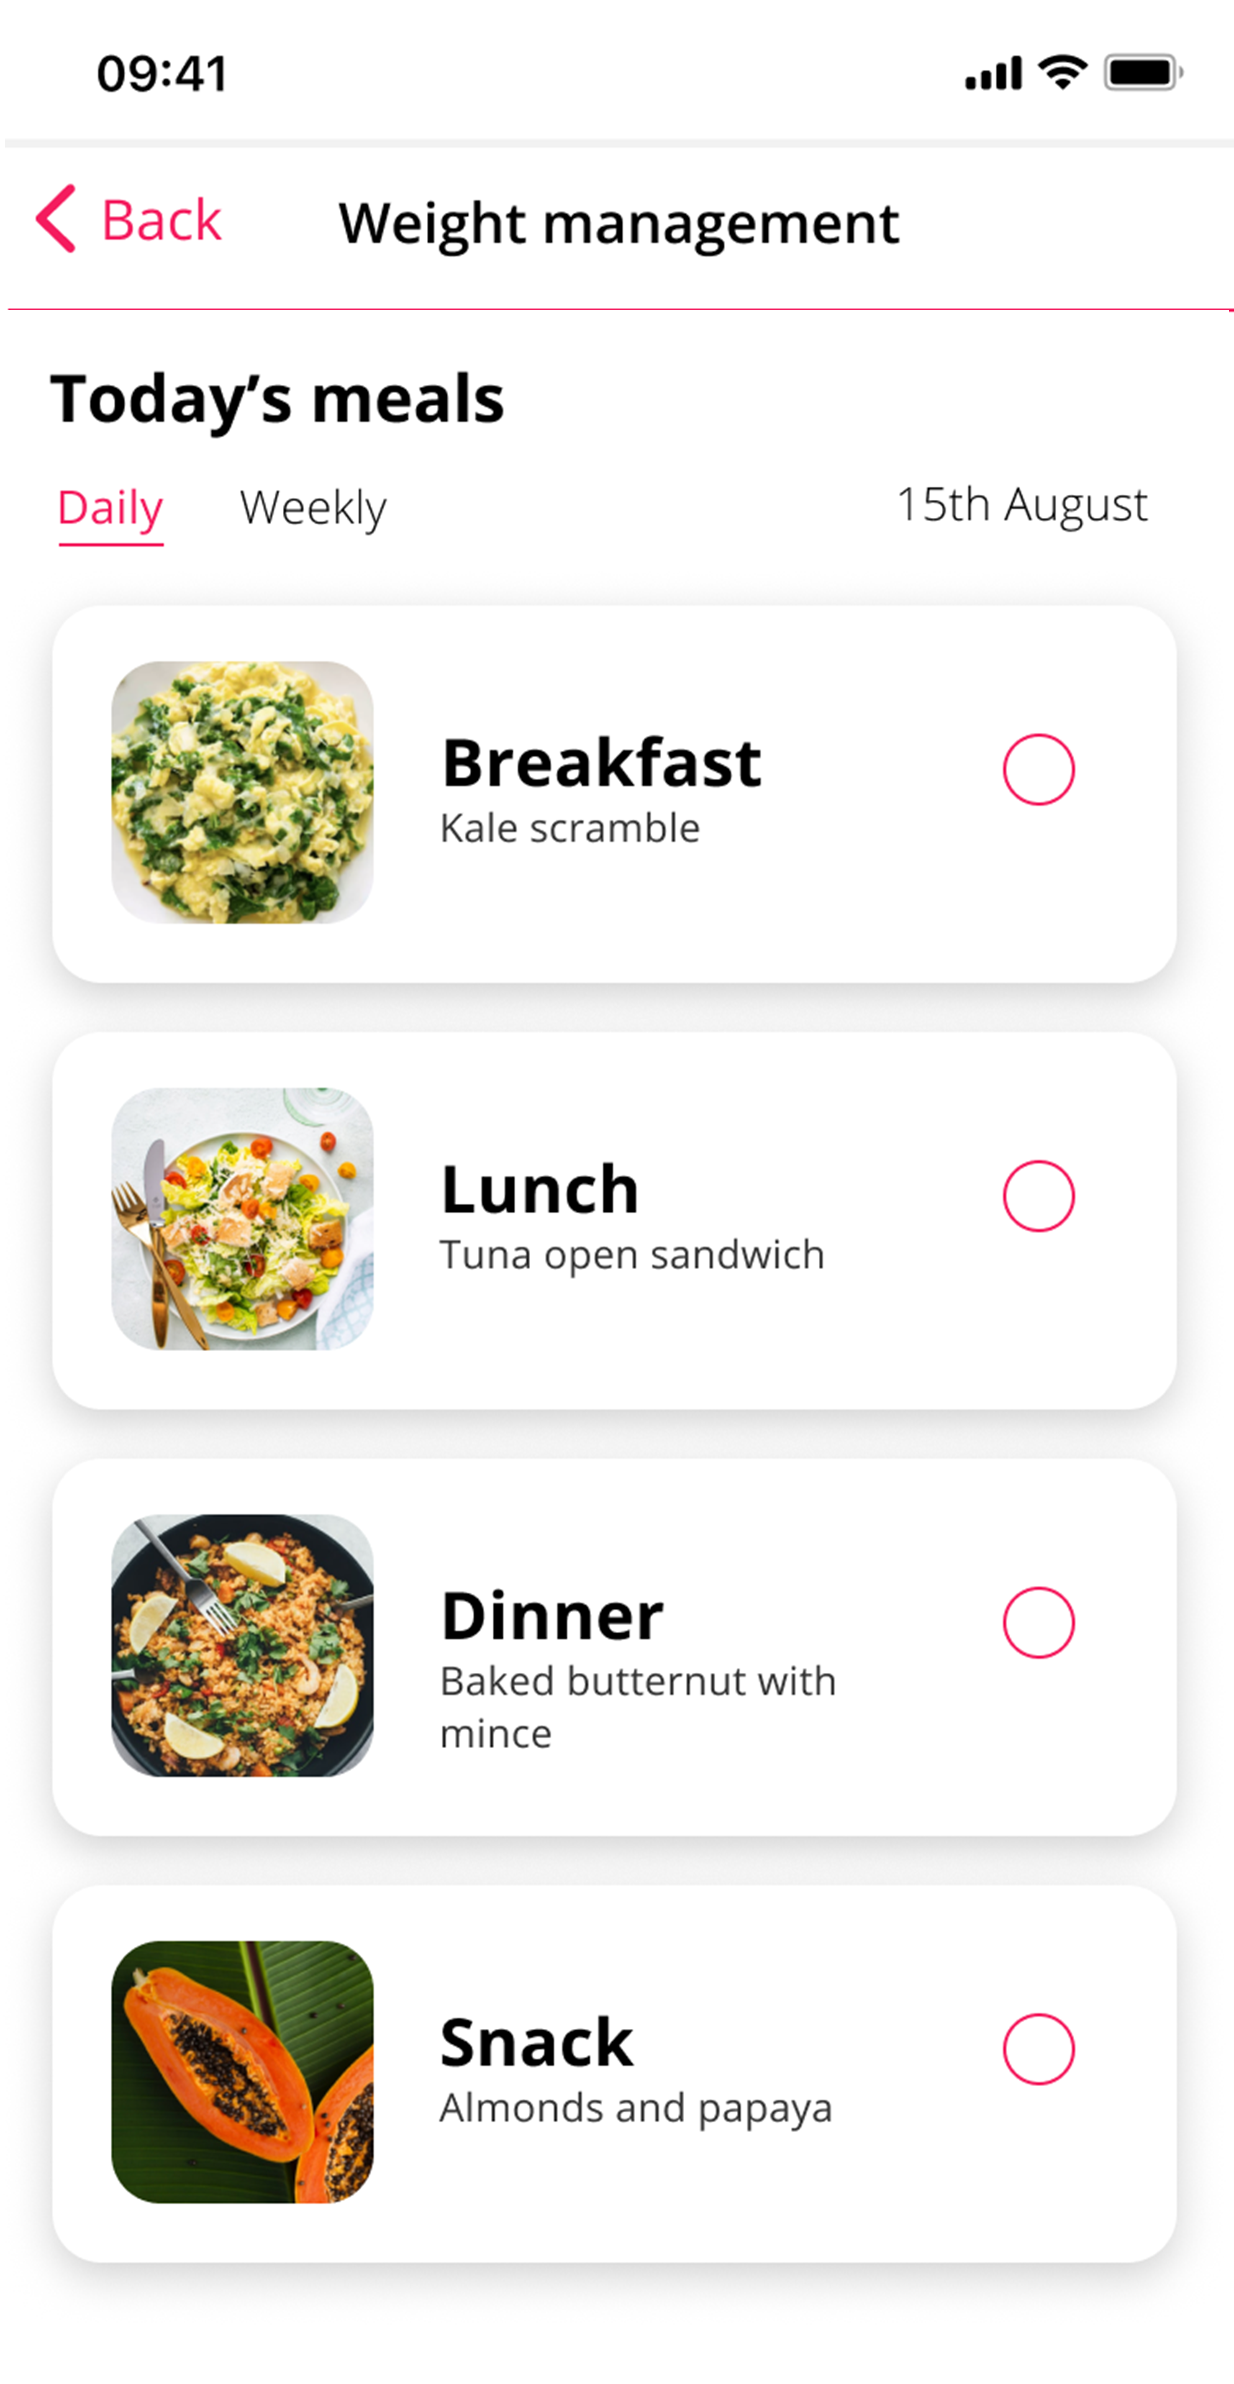
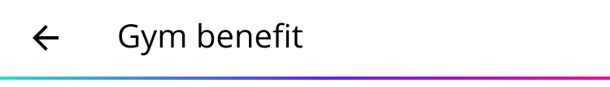




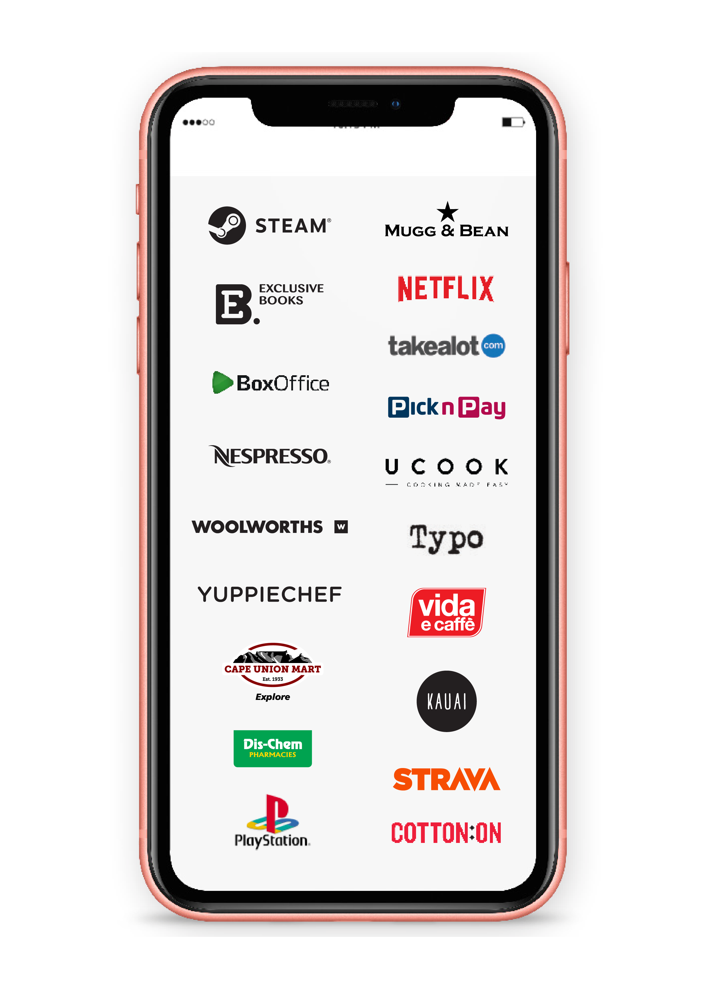



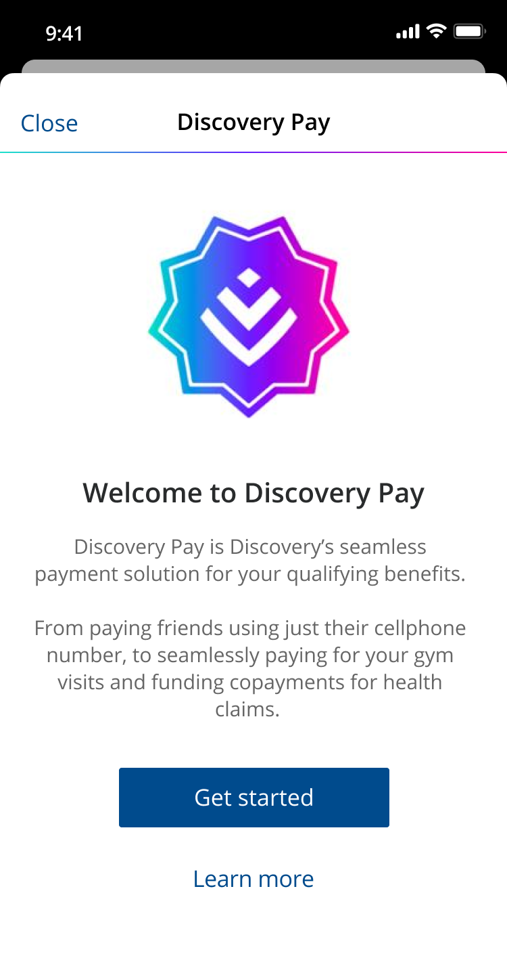






































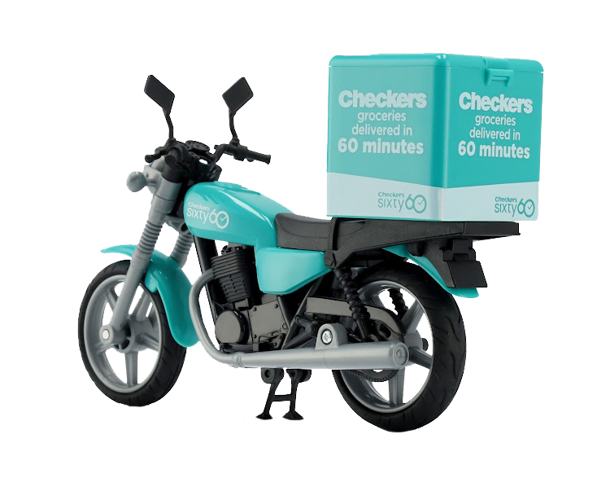
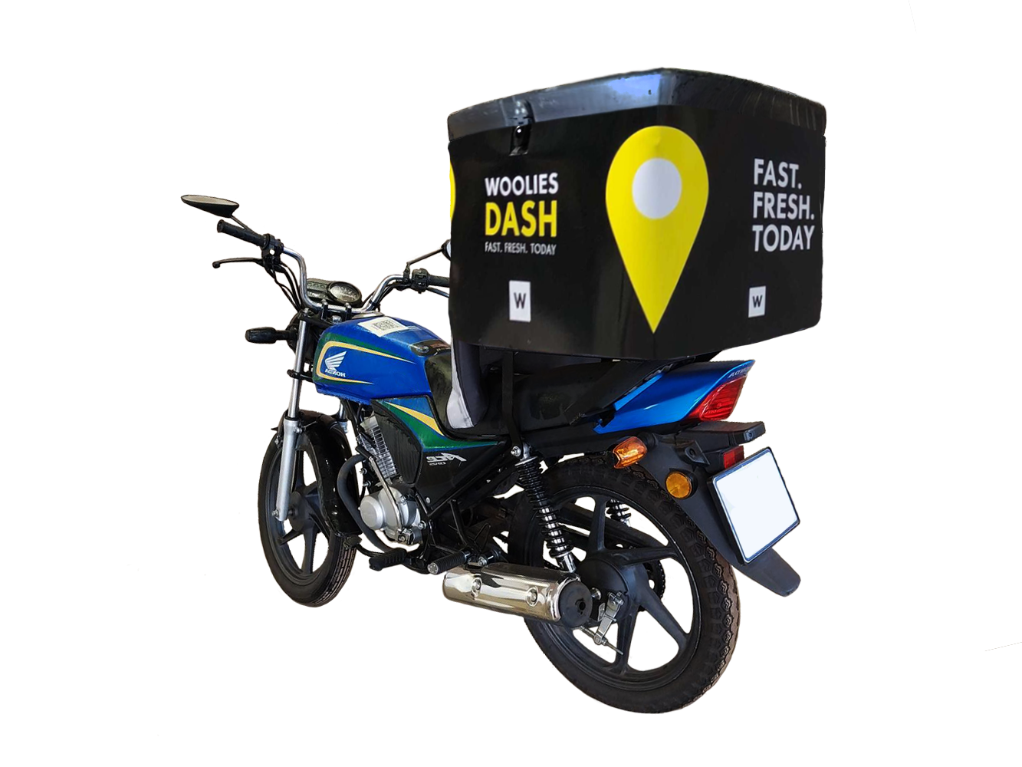













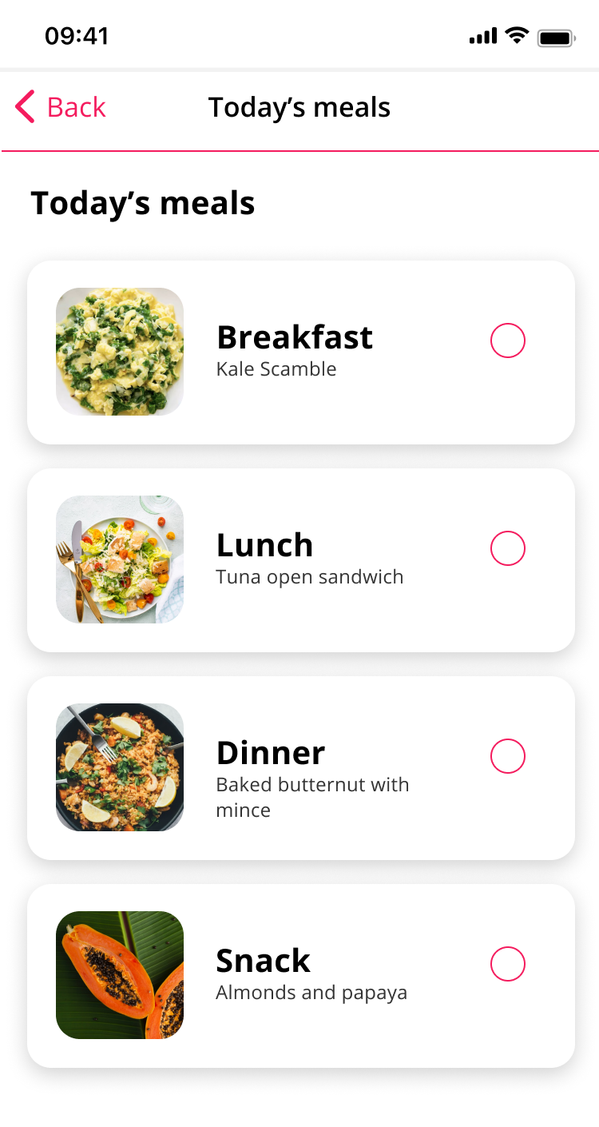




















Vitality in 2025
  GET HEALTHY
  GET REWARDED
GET ACTIVE
EARN DISCOVERY MILES
SPEND DISCOVERY MILES
Spend and Invest
Vitality Mall
Partner network
Instant gym activation
Pay as you gym
Vitality Active Rewards
TEAM VITALITY
Prepaid products
Miles discount
EAT WELL
Vitality
HealthyWeight Programme
TAKE CARE
plus much, much more…

Slide 34
Thank you

