Slide 1
LA Health Launch
2012
On the way to wellness

Slide 2

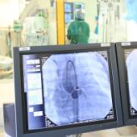


The South African healthcare system is impacted by multiple forces
Economic uncertainty
Technology & information
Regulation
Lifestyle related disease
As the custodian of our members’ care our role is to provide stability and certainty

Slide 3

A key challenge lies in balancing quality and cost to ensure sustainability of medical schemes
Quality ≥ Cost
Healthcare equilibrium
Quality of care
Cost of cover

Slide 4





The LA Health option range caters for varying medical and financial needs
Cost
Extent of cover and access

Slide 5


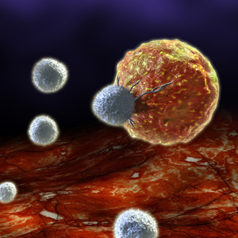

Members can rely on LA Health to look after their health
During 2010, LA Health
 | Welcomed 893 new babies, 26 of whom were premature and required extra care
 | Funded R61.4 million worth of medicine for 17 000 chronic members
 | Paid treatment costs of R28.4 million for the 583 LA Health members with cancer
 | Helped 1 376 HIV positive members manage their condition
Bringing healthcare to you

Slide 6
Members on all options have access to exceptionally high levels of cover
Members can rely on LA Health to look after their health

Slide 7
We offer our members excellent value for money
18% discount to market average
16% discount to market average

Slide 8
Strategies for 2012
1
Provide contribution and benefit stability
2
Use the latest technologies to improve the quality of care
3
Minimise our members out-of-pocket payments
4
Improve members’ health through engagement with Vitality

Slide 9
Strategies for 2012
1
Provide contribution and benefit stability
2
Use the latest technologies to improve the quality of care
3
Minimise our members out-of-pocket payments
4
Improve members’ health through engagement with Vitality

Slide 10
Drivers of the contribution increase
Medical price inflation
Increases in utilisation
Advancements in medical technology
Changes in demographic profile
Reserve funding and solvency requirements

Slide 11
Medical price and utilisation drivers
Price inflation scale
12%
11%
10%
9%
8%
Healthcare goods and services
7%
6%
Consumer goods
5%
4%
3%
2%
1%
Medicine prices
0%
Medical inflation : 5 to 7%

Slide 12
Medical price and utilisation drivers
Number of claimants per 10,000 claiming more than R500,000
(2010 money terms)
Earlier diagnosis → More advanced treatment → Better clinical outcomes; higher costs

Slide 13







Impact of utilisation and medical technologies
Case study: Chronic rheumatoid arthritis
(Increase: 2008 - 2010)
Earlier diagnosis → More advanced treatment → Better clinical outcomes; higher costs

Slide 14
LA Health has achieved phenomenal levels of growth, which has improved the Scheme’s profile
For every year that the Scheme’s average age goes down, claims costs reduce by approximately 2%

Slide 15
LA Health has shown strong simultaneous growth in membership and reserves
Growth in reserves is needed to support membership growth and increasing utilisation

Slide 16
Drivers of the contribution increase
Medical price inflation
Increases in utilisation
8.9%
Advancements in medical technology
Changes in demographic profile
Reserve funding and solvency requirements

Slide 17





2012 contribution increases
Headline increase for 2012 = 8.9%
Benefit structures are unchanged
All limits will be increased in line with inflation
MSA levels will be increased in line with contributions

Slide 18
2012 expected competitive position
LA KeyPlus
Scheme A
Scheme B
Scheme C
Scheme C
Scheme D
Scheme B
Scheme C
Scheme C
Scheme D
Scheme C
Scheme B
Scheme A
Scheme C
Scheme D
Scheme A
LA KeyPlus still offers the greatest value for money in the market
Note : *Assumes an increase of 7% on competitor options
Notes:
Scheme A: Bonitas
Scheme B: Hosmed
Scheme C: Samwumed
Scheme D: KeyHealth

Slide 19
2012 expected competitive position
LA Active and LA Focus
Risk
MSA
Scheme A
Scheme B
Scheme B
Scheme A
Scheme B
Scheme D
LA Active and LA Focus are competitively priced compared to comparable options offered in the Local Government space
Note : *Assumes an increase of 7% on competitor options
Notes:
Scheme A: Bonitas
Scheme B: Hosmed
Scheme D: KeyHealth

Slide 20
Strategies for 2012
1
Provide contribution and benefit stability
2
Use the latest technologies to improve the quality of care
3
Minimise our members out-of-pocket payments
4
Improve members’ health through engagement with Vitality

Slide 21

Electronic health interfaces are being recognised worldwide as effective means of improving the quality of care
E-referrals
In Europe, decreased time spent in referrals by over 50%
E-pathology
Test ordering systems in US and France cut time spent by doctors chasing test results by 70%
Electronic Health Records
In US, composite standards for diabetes care was 35.1% points higher at EHR sites than at paper-based sites. Composite standards for outcomes was 15.2% higher
Technology platform
Central data storage and administration
Fully insured products provide a full view of member claims and medical history data
LA
Notes:
Health is using its partnership with Discovery Health to improve members’ experience in the healthcare system

Slide 22


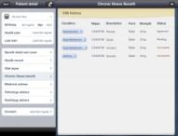


PracticeXpress™: improving efficiency of member treatment
Doctors and Specialists
Claims and healthcare data
Pharma and pharmacies

Slide 23
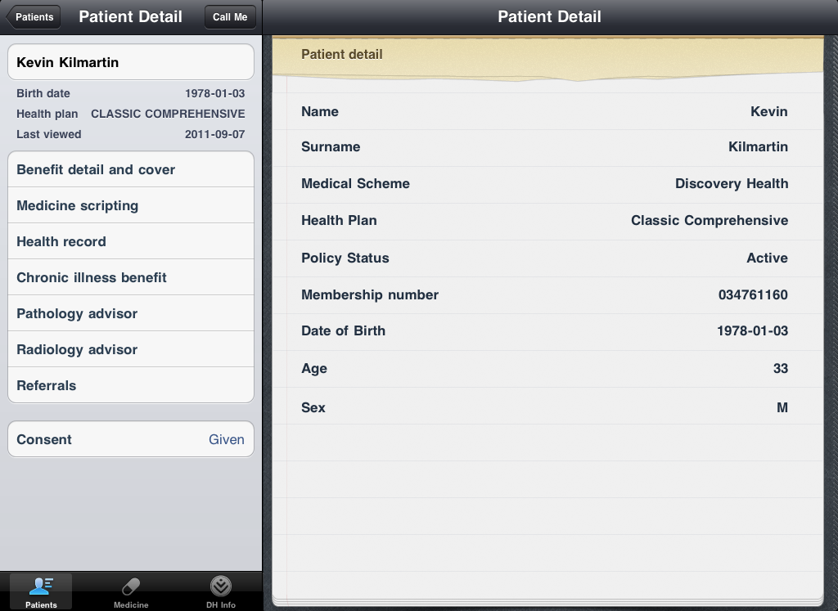
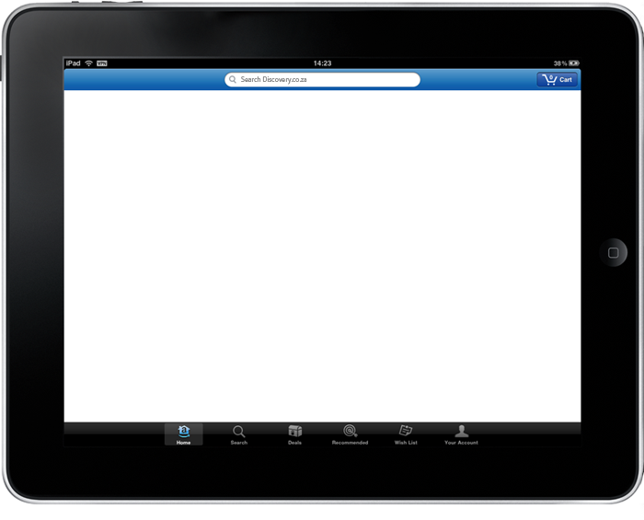
PracticeXpress

Slide 24
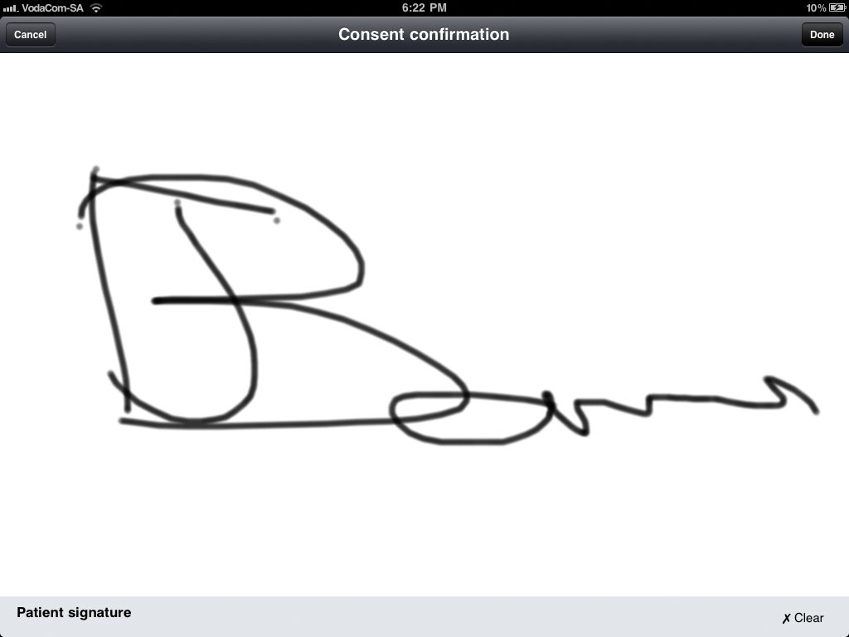
PracticeXpress – Consent
Consent
Members need to give consent to access medical records
This can be done in real time by signing on the iPad screen

Slide 25
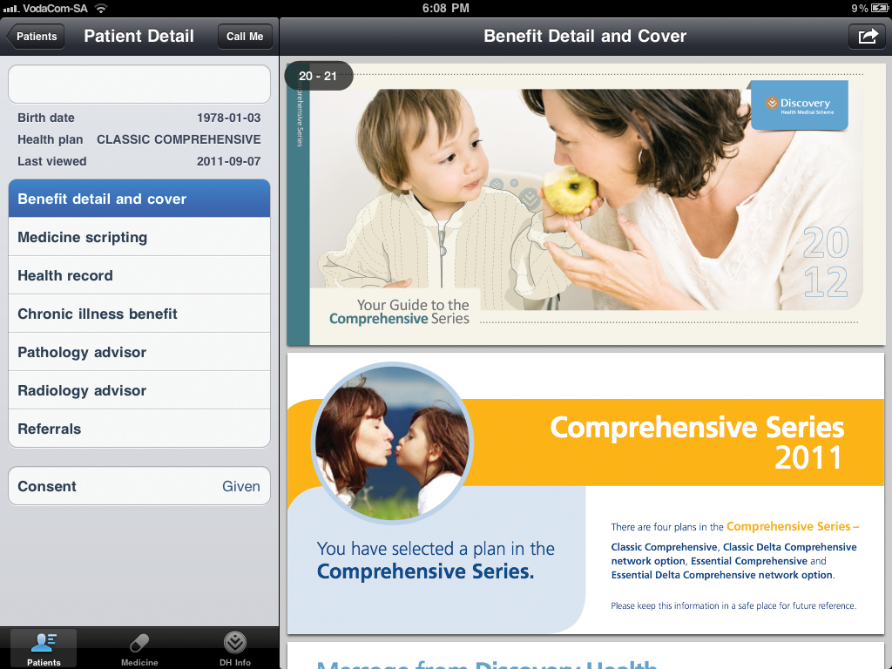
PracticeXpress
Benefit details and cover
Allow for the doctor to view details on the members’ health plan coverage

Slide 26
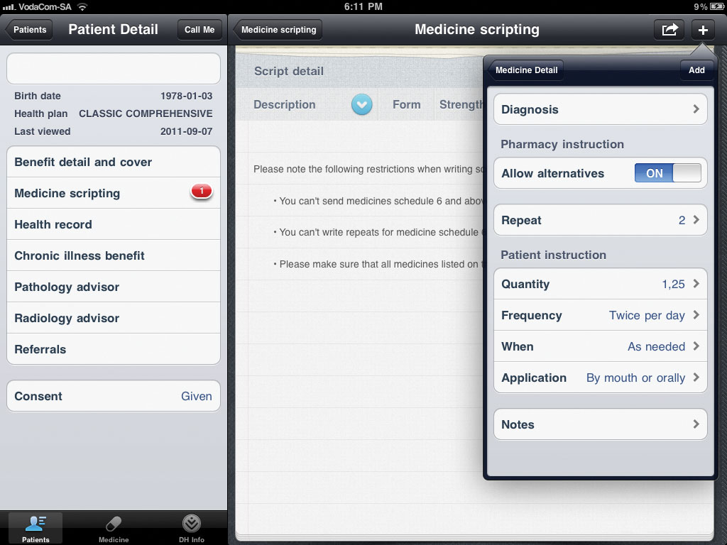
PracticeXpress – Medicine scripting
Medicine scripting
Prescribe medicine for chronic and acute conditions directly from PracticeXpress
Full cover is assured when prescribing medicine from the formulary
Email scripts directly to MedXpress, Discovery Health convenient, cost saving direct medicine delivery service

Slide 27
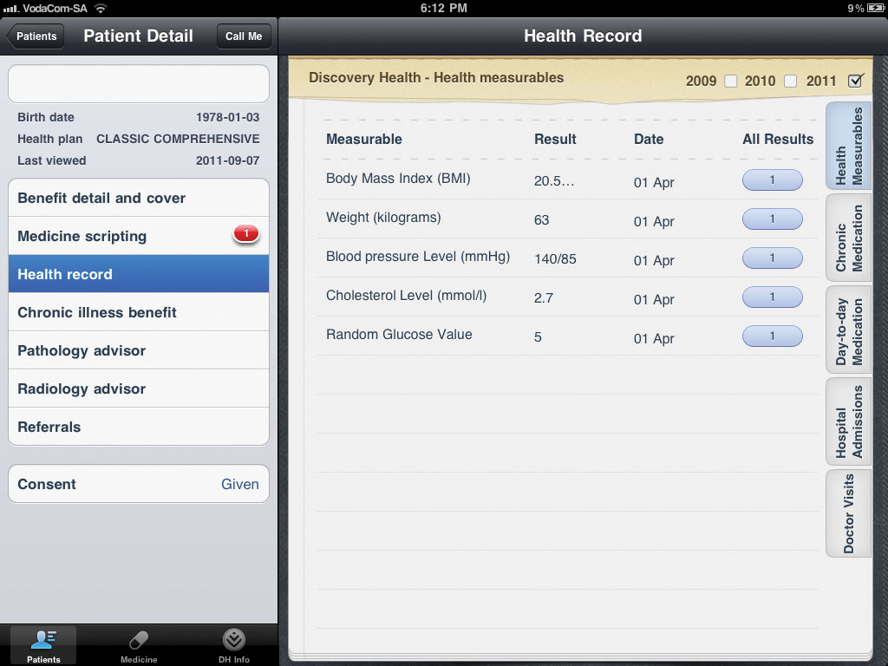
PracticeXpress – Health records
Health records
Access data and details of previous doctor and hospital visits and previously prescribed medicines
Access self-reported health measures such as body mass index and blood pressure

Slide 28
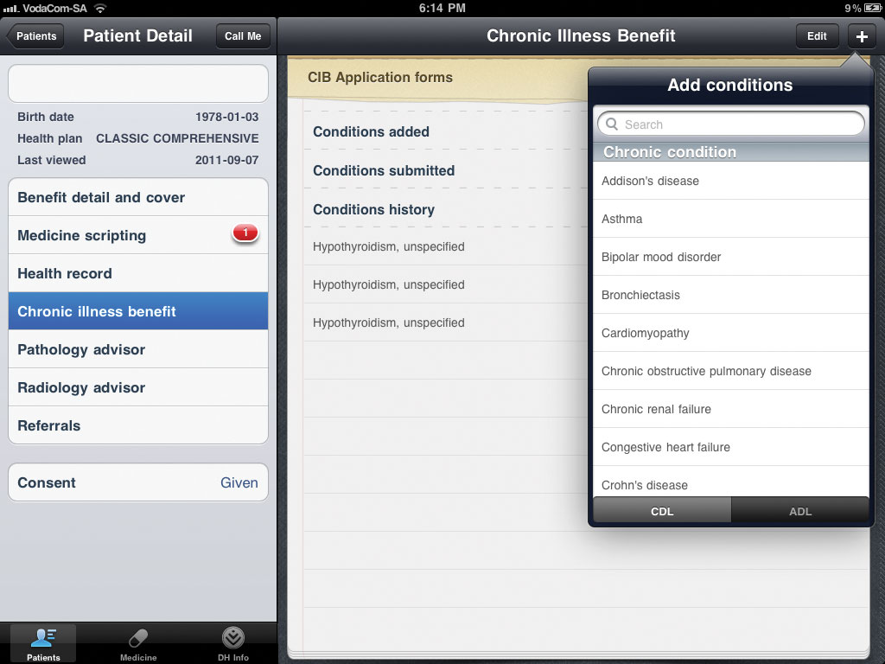
PracticeXpress – Chronic Illness Benefit
Chronic Illness Benefit
Register for a new chronic Illness and complete the necessary clinical entry criteria
Add or change medicines and find cost-effective alternatives
PracticeXpress highlights the Full Cover Choice when prescribing medicine, and shows the medicine formulary

Slide 29
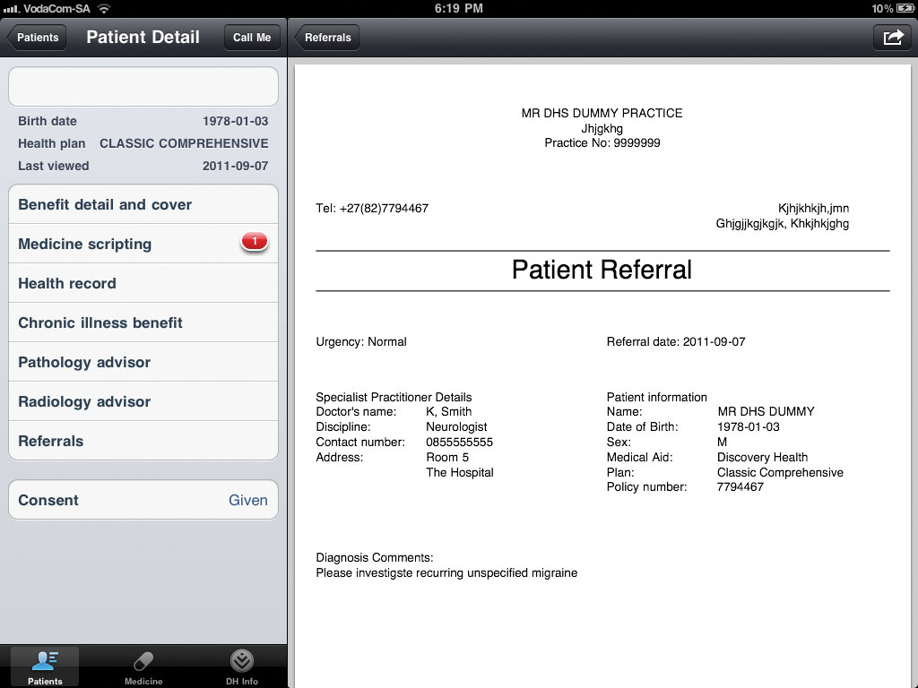
PracticeXpress – Referrals
Referrals
Refer a patient to another healthcare professional by submitting a clinically detailed report using the patient referral tool on PracticeXpress
Referral information is stored for each patient and a record of all referrals is summarised on PracticeXpress

Slide 30
Strategies for 2012
1
Provide contribution and benefit stability
2
Use the latest technologies to improve the quality of care
3
Minimise our members out-of-pocket payments
4
Improve members’ health through engagement with Vitality

Slide 31
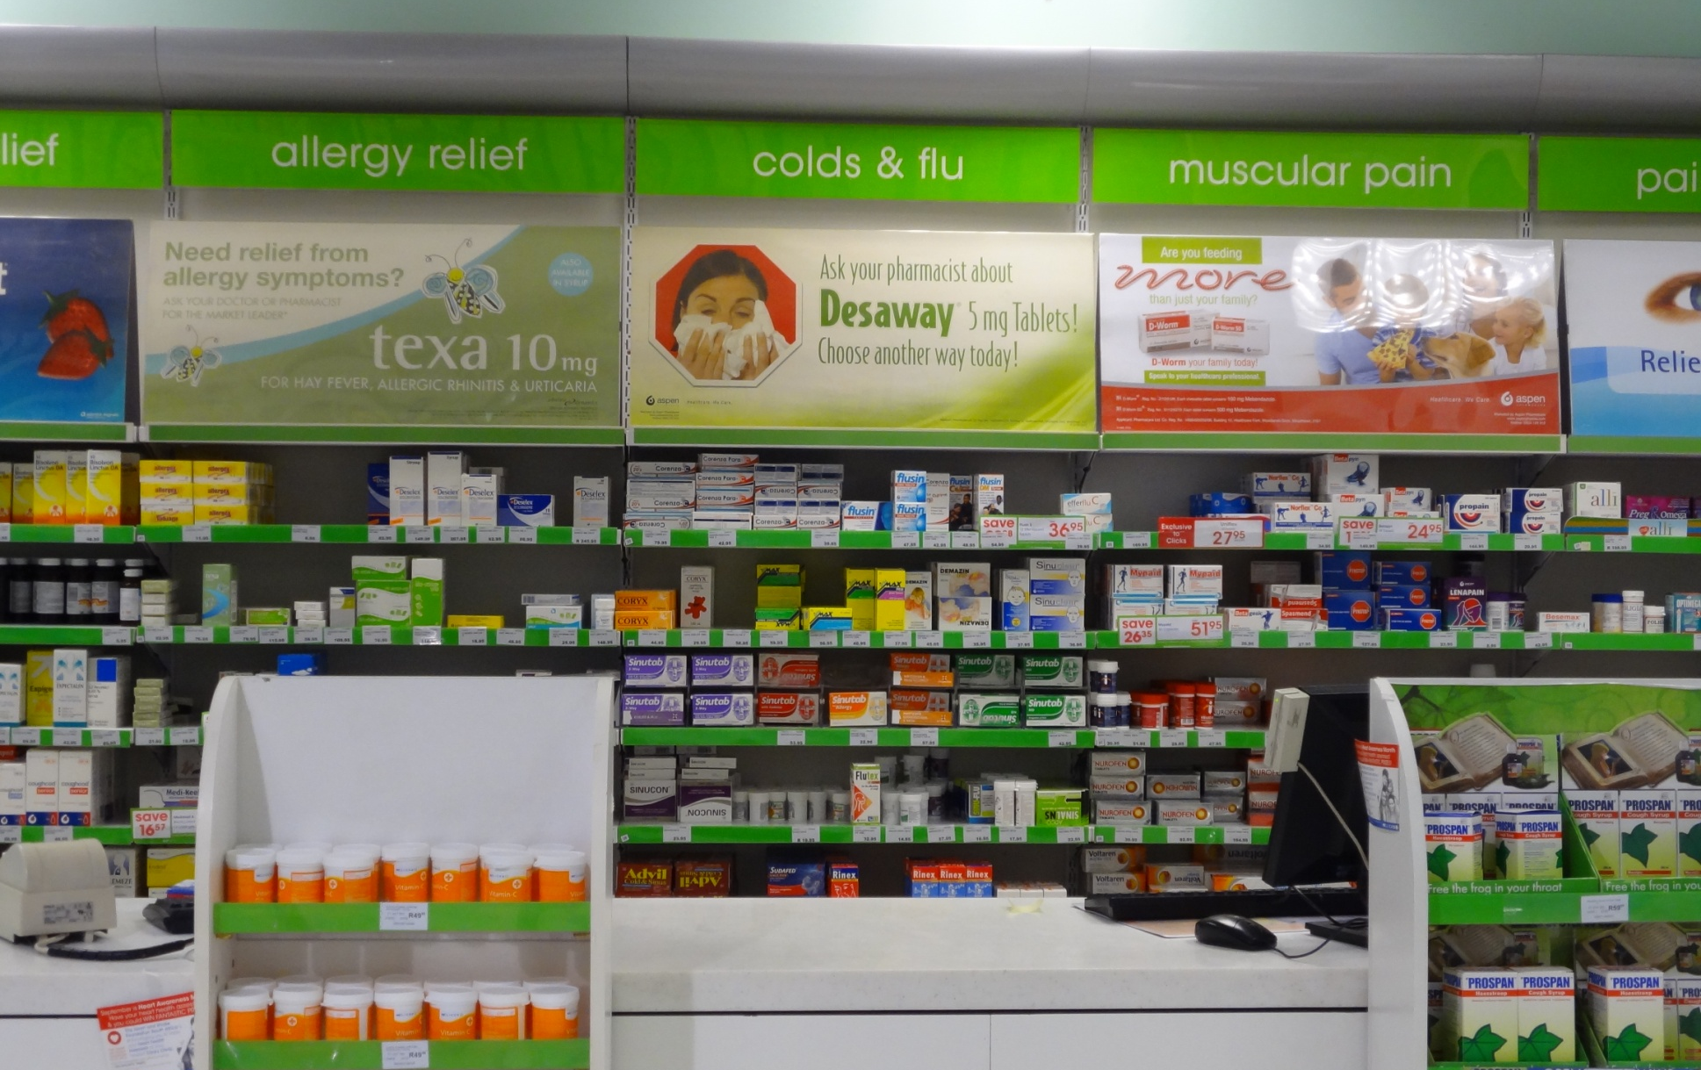
Over-the-counter medicines are a common source of day-to-day medical costs
In the last year Discovery members spent R550 million on schedule 1 and 2 medicines

Slide 32

Get up to 25% cash back on schedule 1 and 2 medicine
MedSaver
in partnership with

Slide 33
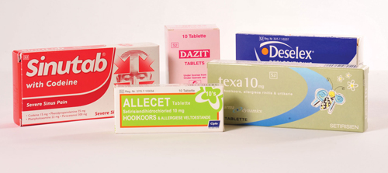
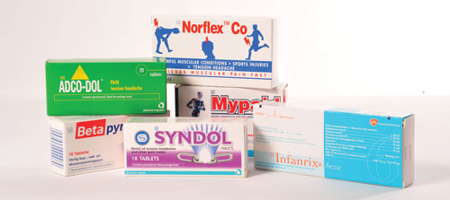
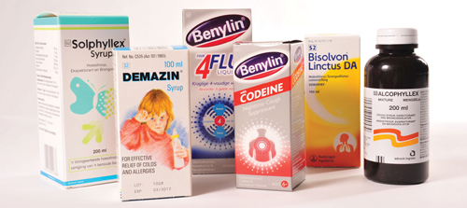
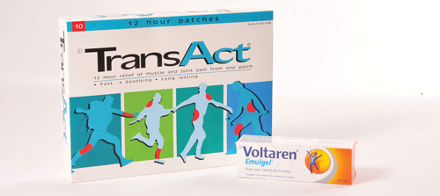

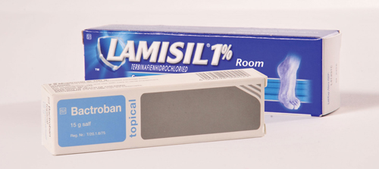
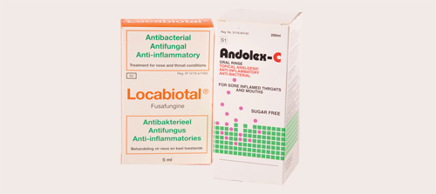
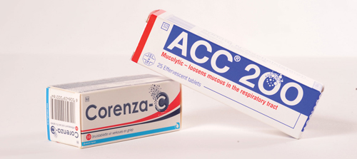
Most frequently purchased schedule 1 and 2 medicines
Allergies
Pain
Coughs
Muscular pain
Cramps and spasms
Skin conditions
Throat ailments
Colds and flu

Slide 34



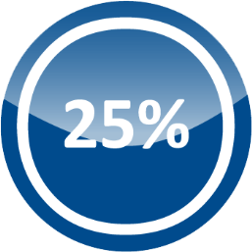

The MedSaver benefit in action
Activate
MedSaver
Complete a
Vitality Check
Visit a
Clicks store
Enjoy the
rewards
Go to
www.discovery.co.za
to activate
At a pharmacy in the Vitality Wellness Network or a Wellness Day
Purchase schedule 1 and 2 medicines
Earn up to 25% cash back

Slide 35
MedSaver: Technical details
1
The MedSaver benefit is available to all LA Health members, subject to activation on www.discovery.co.za
2
Members do not need to swipe any card when purchasing their schedule 1 and 2 medicines to receive their MedSaver cash back
3
The MedSaver cash back will be paid into the member’s DiscoveryCard or any other nominated bank account every month

Slide 36
Strategies for 2012
1
Provide contribution and benefit stability
2
Use the latest technologies to improve the quality of care
3
Minimise our members out-of-pocket payments
4
Improve members’ health through engagement with Vitality

Slide 37
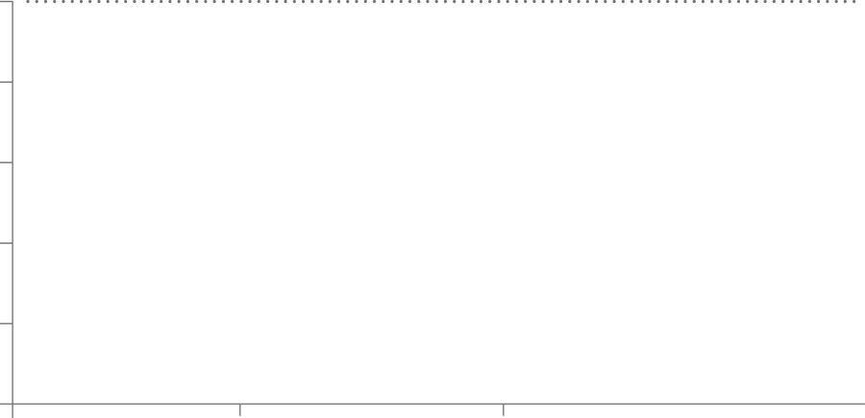



The impact of Vitality on members’ health
Engaged Vitality members experience lower healthcare costs
100%
7%
95%
14%
90%
85%
80%
75%
Non-Vitality
Blue
Bronze +

Slide 38


Vitality strategies for 2012
Drive engagement through
HealthyLiving™
Refine and optimise incentive structures

Slide 39
Vitality strategies for 2012
Drive engagement through
HealthyLiving™
Refine and optimise incentive structures

Slide 40


Using HealthyFood™ as a template for HealthyLiving™
1
Market-leading partner
473 stores nationwide
2
Make a tangible financial impact
25% cash back
More than R200m in rewards
3
Focus on key health impact areas
20% increase in healthy basket
4
Utilise incentives to drive engagement

Slide 41
Impact of HealthyFood™ on health awareness
Increase in Vitality tests since inception of HealthyFood™

Slide 42
Using HealthyFood™ as a template for HealthyLiving™
1
Market-leading partner
473 stores nationwide
2
Make a tangible financial impact
25% cash back
More than R200m in rewards
3
Focus on key health impact areas
20% increase in healthy basket
4
Utilise incentives to drive engagement
250% increase in PHR’s

Slide 43

Vitality HealthyLiving™

Slide 44

Vitality HealthyCare™
25% Saving on all HealthyCare™ products at Clicks

Slide 45

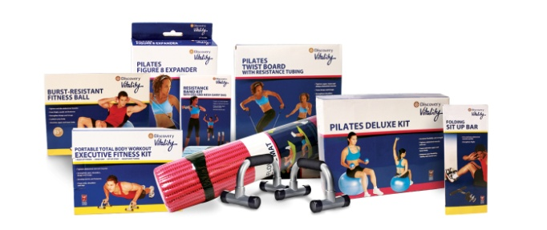


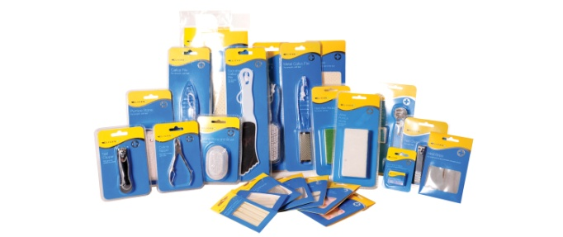




HealthyCare™ product range
Dental care
Exercise equipment
Eye care
First aid
Foot care
Self care
Smoking cessation
Sun care
Nutritional supplements

Slide 46
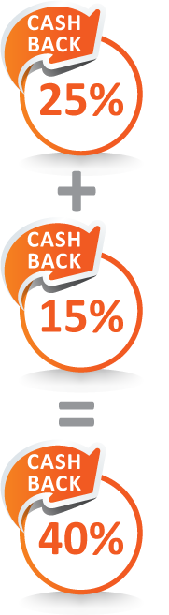

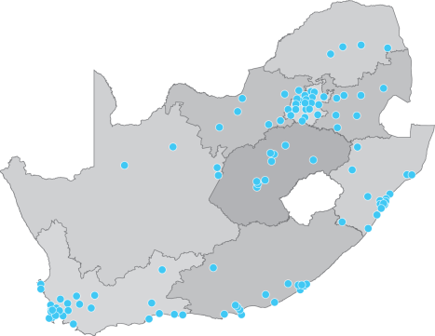

Introducing HealthyCare™ in partnership with Clicks
Activate on www.discovery.co.za
Complete a Vitality Check
Swipe your HealthyCare™ at any Clicks store
Enjoy greater cash back rewards
HealthyCare™
Current Vitality benefit
Get 25% cash back
Over 400 stores nationwide
Additive to existing rewards
Get 10% cash back
Note:
Each member aged 18 and older can get the HealthyCare™ saving on a maximum of R1 500 spent on HealthyCare™ products in a month. Members can get the standard Clicks cash back rewards on a maximum of R15 000 they spend on any products at Clicks in a year. The Vitality Check will apply to both the HealthyCare™ and the MedSaver benefit.

Slide 47

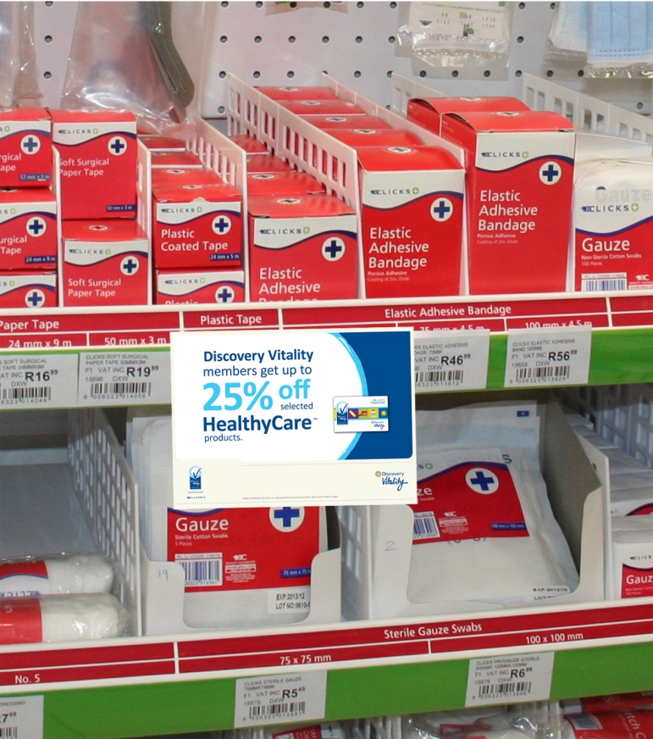

HealthyCare™ store branding

Slide 48
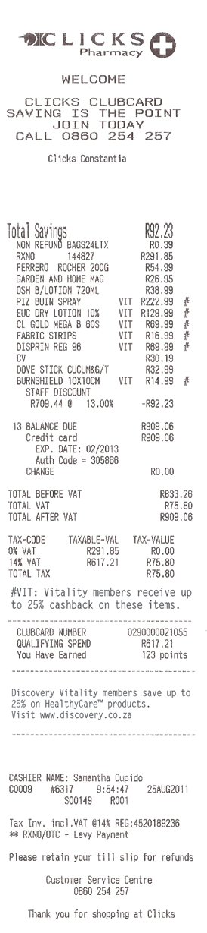

Case study: HealthyCare™ Benefit
HealthyCare™ purchases:
R 524.94
HealthyCare™ cash back:
R131.24

Slide 49

Vitality HealthyLiving™

Slide 50
The impact of exercise on health
Vitality longitudinal study:
Fitness engagement is directly correlated to better health claims experience
5% reduction in hospital costs for every additional gym visit
Number of additional gym visits per week from Year 1 to Year 3
Focus on engaging Vitality members in exercise

Slide 51
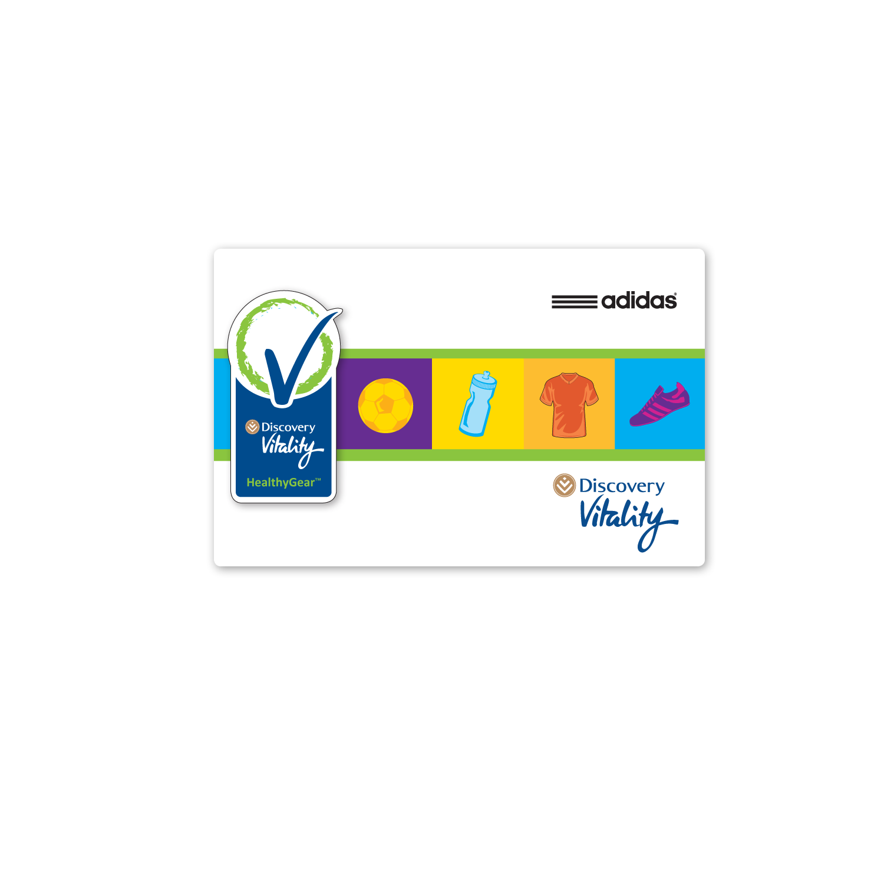

Vitality HealthyGear™
25% Saving on all HealthyGear™ products at .....adidas...... and Totalsport

Slide 52











The HealthyGear™ product range
Training
Tennis
Running
Outdoor
miCoach
Kids
Rugby
Swimming
Basketball
Soccer
is all in

Slide 53
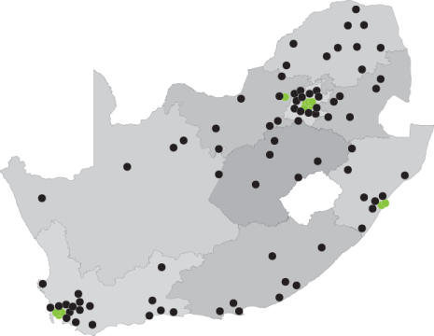
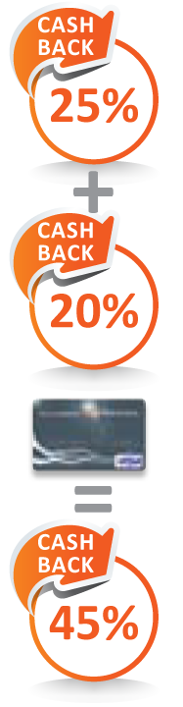
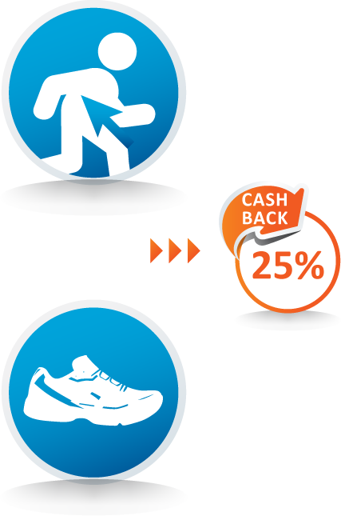


Maximising your savings with the HealthyGear™ benefit
Activate on www.discovery.co.za
Complete a Fitness Assessment online or at a biokineticist in the
Vitality Wellness Network
Swipe your HealthyGear™ card at any adidas store or your DiscoveryCard at any Totalsports store
Enjoy greater cash back rewards
Broad national footprint
Additive to existing rewards
Get 10% cash back
Get 25% cash back
Note:
As a family, members get savings on a maximum of R15 000 spent on HealthyGear™ in a year. DiscoveryCard cash back limits apply.

Slide 54
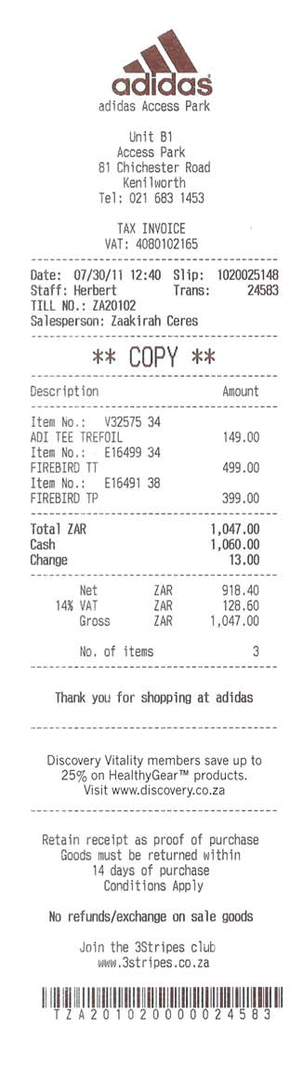
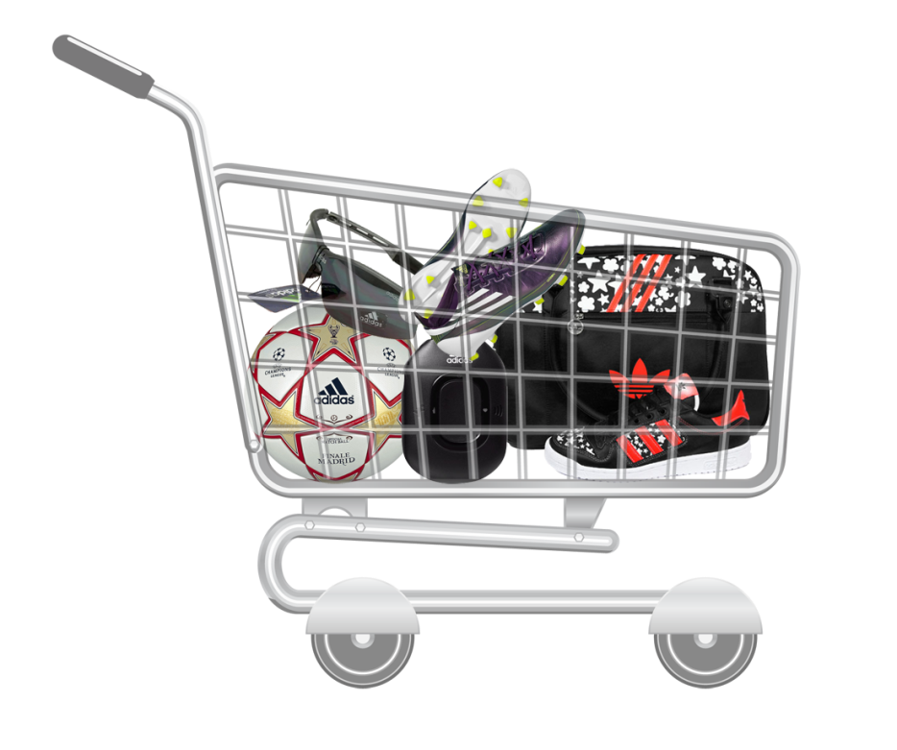
Case study: HealthyGear™ Benefit
Total Value of Purchases:
R 1,047
HealthyGear™ cash back:
R261.75

Slide 55







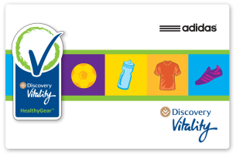

Bringing down the costs of healthy living for members
1
Activate online at www.discovery.co.za and get 10% cash back
MedSaver
HealthyFood™
HealthyGear™
HealthyCare™
2
Know your health and get 25% cash back
Complete a Personal Health Review
v
Have a Fitness Assessment
Go for a Vitality Check
Go for a Vitality Check
Improve your Vitality status and get even more rewards
3
Additional DiscoveryCard rewards
Up to 45% when paying with your DiscoveryCard at Totalsports
Up to 40% when swiping your Vitality Clicks ClubCard

Slide 56
Vitality strategies for 2012
Drive engagement through
HealthyLiving™
Refine and optimise incentive structures

Slide 57
Refining the Vitality program in 2012
1
Improving the clinical efficacy of the points allocation through a shift to outcomes based points
2
Use the benefit design to drive increased levels of physical activity
3
Integrate and simplify Card rewards

Slide 58
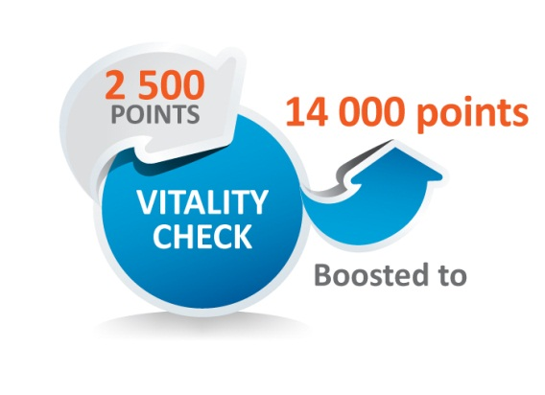
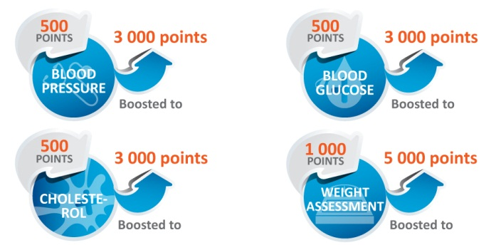

Incentivise improved health and fitness results
Vitality Check
Level 5: 15 000
Fitness Assessment
Level 4: 13 000
Level 3: 10 000
Level 2: 7 500
Participation: 3 000

Slide 59
Refining the Vitality program in 2012
1
Improving the clinical efficacy of the points allocation through a shift to outcomes based points
2
Use the benefit design to drive increased levels of physical activity
3
Integrate and simplify Card rewards

Slide 60
Driving increased activity
Membership on the Vitality gym benefit
Gym benefit restructured to improve access and engagement
Minimum number of visits increased to 36 per year in 2012 to encourage minimum levels of engagement
Benefit reduces from 80% to 50% for members that fall below minimums until they catch up

Slide 61
Refining the Vitality program in 2012
1
Improving the clinical efficacy of the points allocation through a shift to outcomes based points
2
Use the benefit design to drive increased levels of physical activity
3
Integrate and simplify Card rewards

Slide 62
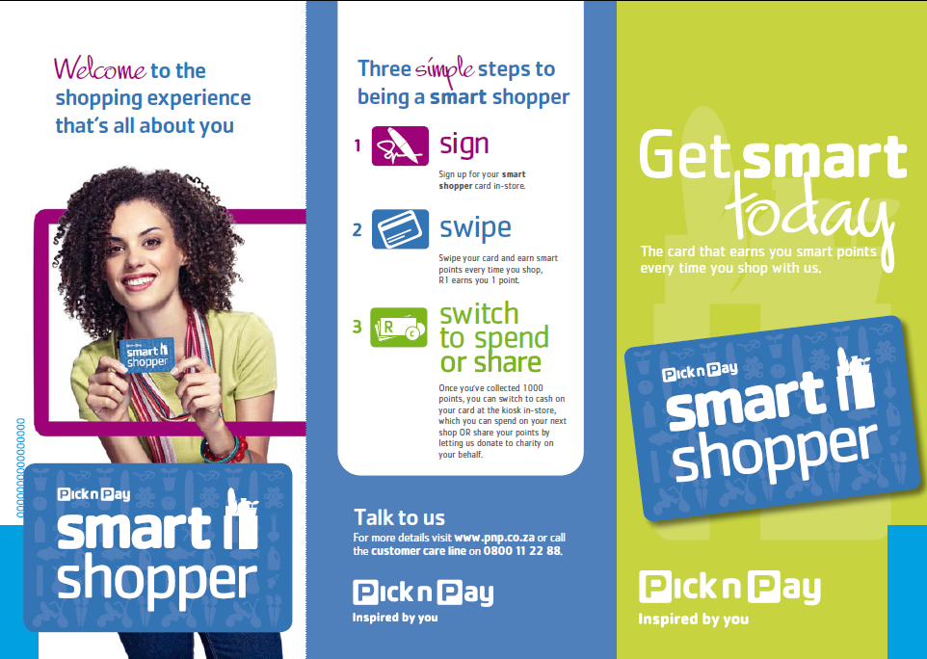
Integration with market-leading partner
The Pick n Pay smart shopper program
3.9 million customers registered
R1 of spend = 1 smart shopper point
1000 points = R10 cash back

Slide 63







Integrate and simplify card rewards
Points multiplier points based on Vitality status
Blue
X 2
Bronze
X 4
Silver
X 6
Gold
X 8
Diamond
X 10
Integration with smart shopper replaces card cash back mechanism. No sub-limits on expenditure apply to the 2012 smart shopper multiplier benefit

Slide 64
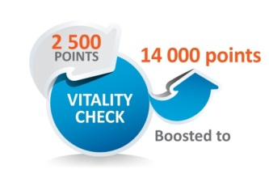
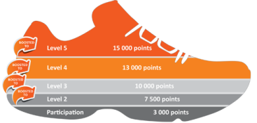


Refining the Vitality program in 2012
1
Improving the clinical efficacy of the points allocation through a shift to outcomes based points
2
Use the benefit design to drive increased levels of physical activity
3 Visits per month
3
Integrate and simplify Card rewards

Slide 65


Strategies for 2012
1
Provide contribution and benefit stability
8.9%
2
Use the latest technologies to improve the quality of care
3
Minimise our members out-of-pocket payments
MedSaver
4
Improve members’ health through engagement with Vitality

Slide 66
LA Health Launch
2012
On the way to wellness

